Slide 1
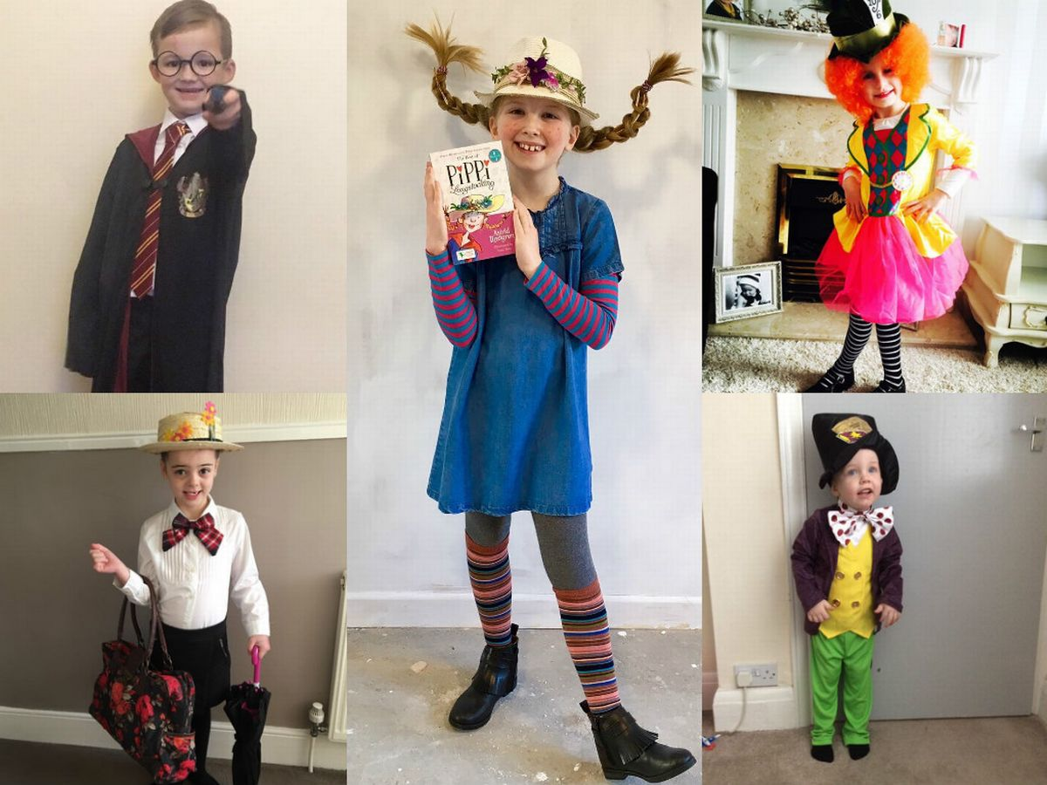
Masefield Primary School ‘Book Week’ Challenges: Y5 & Y6
It’s Book Week!
The theme for this year’s book week is ‘share a story’. We would like you to get involved in Book Week at home by having a go at some of the challenges below. Feel free to add to this list with your own ideas!
Book week challenges
Monday
Watch the video of ‘Shh, we have a plan’ by Chris Haughton. Write a sequel for this story in which the four characters try to catch the squirrel.
Tuesday
Most of the illustrations in Chris Haughton’s book use different shades of blue. Could you try to create your own illustrations from the book using different shades of the same colour?
Wednesday
Take a walk outdoors and list the wildlife you can see, you could even take some photos. When you get back, draw, paint or recreate the animals you encountered on your adventure. You could use natural resources such as leaves, sticks, stones and feathers within your art work!
Thursday – World Book Day!
Dress up as your favourite book character! It would be really impressive if you could make parts of your costume yourself! Make a video of you reading or telling a story to the audience. Can you use your best story teller voice to keep your story interesting to the listeners?
Friday
Use 2DIY3D on Purple Mash to design a computer game in which the four characters have to try and catch a bird.
Websites you might like to visit
https://www.worldbookday.com/
https://www.chrishaughton.com/
https://www.bbc.co.uk/teach/live-lessons/world-book-day-live-lesson
https://www.worldbookday.com/ resources/primary/
Dress up on Thursday and send us a Twitter picture! @MasefieldCP

