Slide 1
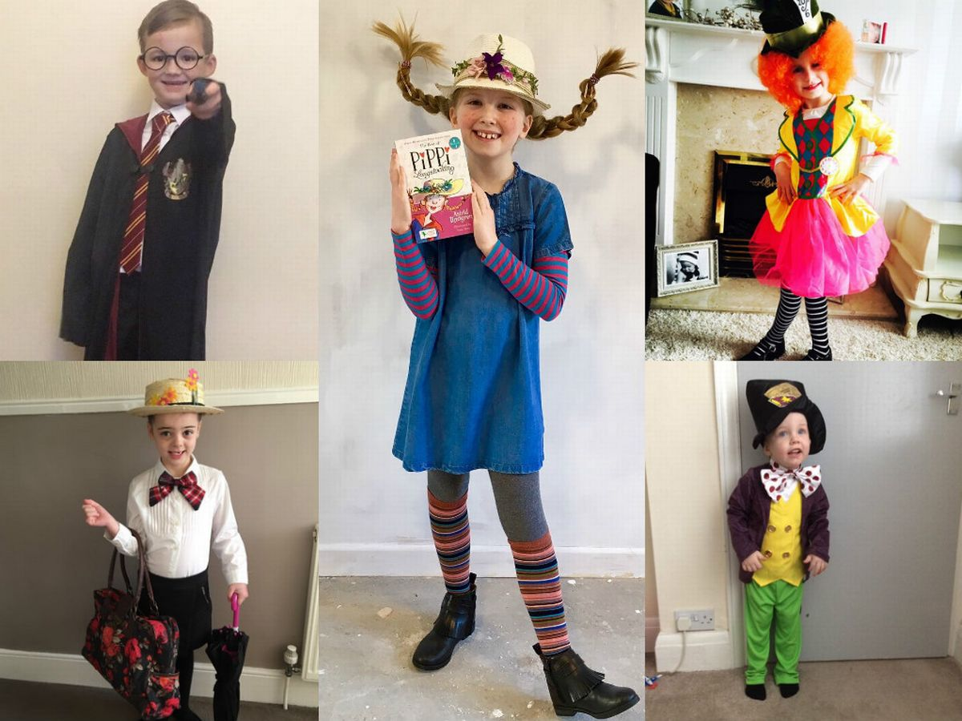
Masefield Primary School ‘Book Week’ Challenges: LKS2
It’s Book Week!
The theme for this year’s book week is ‘share a story’. We would like you to get involved in Book Week at home by having a go at some of the challenges below. Feel free to add to this list with your own ideas!
Book week challenges
Monday
Watch the video of ‘Shh, we have a plan’ by Chris Haughton. Take a nature walk outside. What wildlife can you see in the sky, on the ground, or even beneath the earth? Write it down or perhaps take a picture/video. When you get back home draw, paint or recreate the animals you encountered on your adventure. You could even use natural resources from your travels such as leaves, sticks, stones and feathers within your art work!
Tuesday
Research Activity - Research different types of birds to see what you can find out about the brightly coloured birds from Shh! We Have a Plan. What kind of birds could they be? What habitats might they live in?
Wednesday
Each of the characters in Shh! We Have a Plan carries a bag or backpack on their journey. What do you think is in each bag? At home lay out a small bag and several different objects that may be needed on such an adventure. Then order your items from the most important all the way down to the least important.
Thursday – World Book Day!
Dress up as your favourite book character! It would be really impressive if you could make parts of your costume yourself! Make a video of you reading or telling a story to the audience. Can you use your best story teller voice to keep your story interesting to the listeners?
Friday
Let’s act it out! Can you make stick puppets using card and sticks then act out your story?
Websites you might like to visit
https://www.worldbookday.com/
https://www.chrishaughton.com/
https://www.worldbookday.com/ resources/nursery/
https://www.worldbookday.com/ resources/primary/
Dress up on Thursday and send us a Twitter picture! @MasefieldCP

